Slide 1

Videoclub
Lucia Costilla

Slide 2


Cleaning Databases with Pandas
Imported 7 csv files.
Started to clean dirty columns. That means eliminating empty spaces or re-naming some columns in order to be easier to work with those.(Such as name = genre)
Lastly checking which information was important to join in SQL as they have the same information (category_id with category_id)
Once I had all the necessary information I've imported certain libraries that helped me to migrate the information to SQL

Slide 3
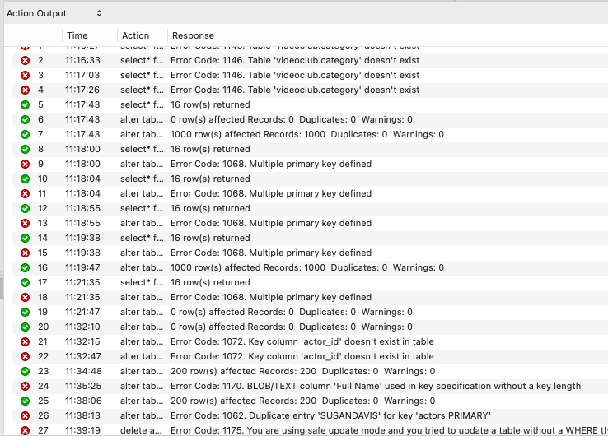
After all this ERRORS I was able to create … ✨

Slide 4
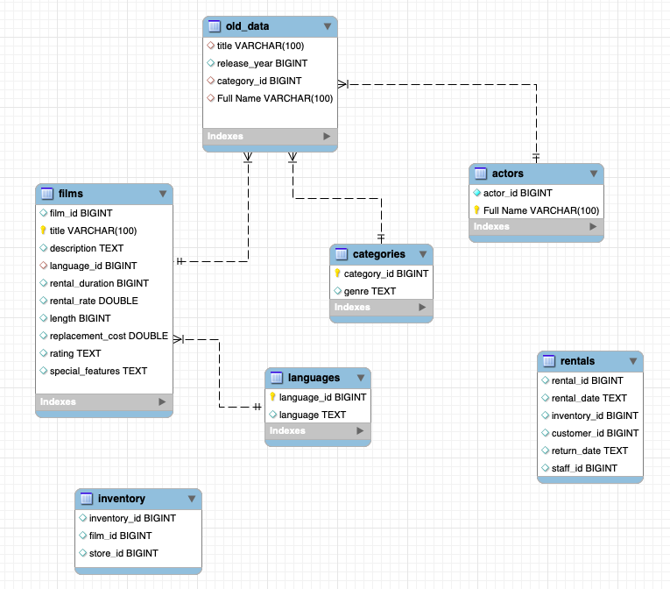
Errors solved ✅
This is how I defined →
🔑 Primary Keys
♦️ Foreign Keys

Slide 5



FILM: "AFRICAN EGG"
Description
Film_id
Language_id

Slide 6

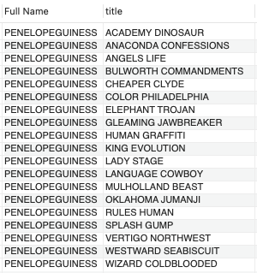

Actress: " PENELOPE GUINESS "
Film Titles
Penelope

Slide 7

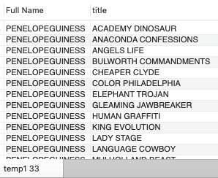
Create Temporary Table with data from Actress Penelope Guiness
Penelope

Slide 8


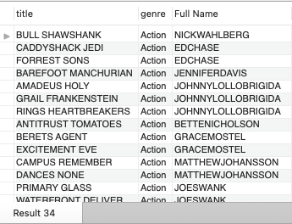
Genre: Action
Title
Actor/Actress Full Name

Slide 9

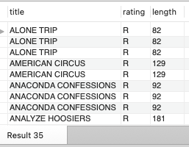

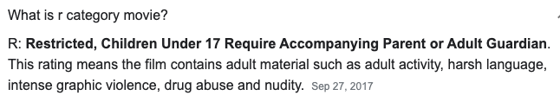
Check all movies with R - Rating
Film Title →
Film length

Slide 10

QUESTIONS?
Lucia Costilla

